Slide 1

Navigating the AI Tidal Shift
Preparing for Disruption, Divergence & Resilience
July 25, 2025

Slide 2



Why This Matters Now
AI already meets professional benchmarks — GPT‑4 passed the bar exam while ChatGPT is at or near the passing threshold for the USMLE medical boards.
85M jobs displaced by 2025 (WEF)
Financial markets reflect this enthusiasm — the S&P 500 reached record highs in June 2025 amid renewed AI optimism.
300M jobs exposed globally to AI
The stakes are huge — forecasts suggest 85 million jobs may be displaced by 2025 and up to 300 million roles worldwide could be exposed to automation.
S&P 500: 6,178 All‑time high
[1][2][3][4][5]

Slide 3



What AI Can Do Today
Professional exams
Medical diagnosis
GPT‑4 scored around 75% on the bar exam and placed in the 90th percentile.
ChatGPT performed at or near the passing threshold on USMLE Step 1, 2CK and 3 without specialised training. Beyond chatbots, foundation models trained on millions of retinal images can detect eye diseases and even predict systemic conditions like heart failure and myocardial infarction.
Generative creativity
Realistic voices
LLMs can draft software, contracts and presentations from natural‑language instructions — modern coding copilots can finish complete functions or even entire programs from a high‑level prompt.
Voice‑cloning systems can reproduce a person’s speech from just a few seconds of audio, enabling plausible scams and misinformation.
[6][7][8][9][10]

Slide 4
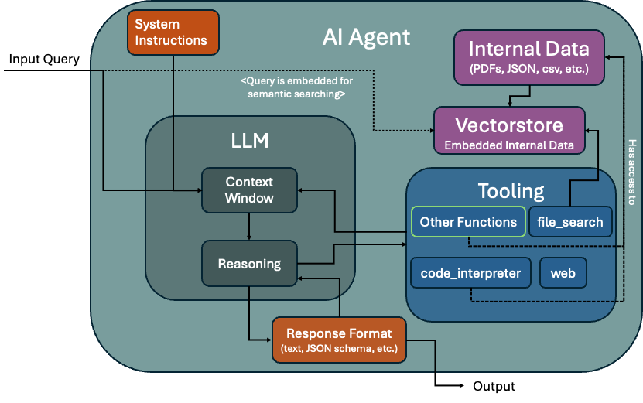
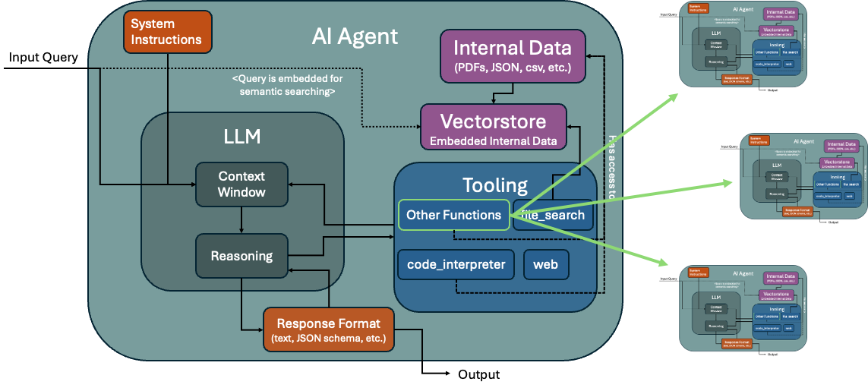
Agentic AI Evolution
Single agent One large language model integrates memory, retrieval and a toolbox (web search, code execution, file I/O) to answer questions in a linear workflow. Multi‑agent An orchestrator coordinates specialised agents, each with its own LLM and tools, enabling concurrent tasks and division of labour across planning, execution and feedback. Key features • Autonomy & decentralisation • Collaboration & competition • Scalability & adaptability
Single‑agent architecture
Multi‑agent architecture (e.g., sequential AI agent calls, orchestrator with AI agent tool access, or a combination of both)
[12][13]

Slide 5
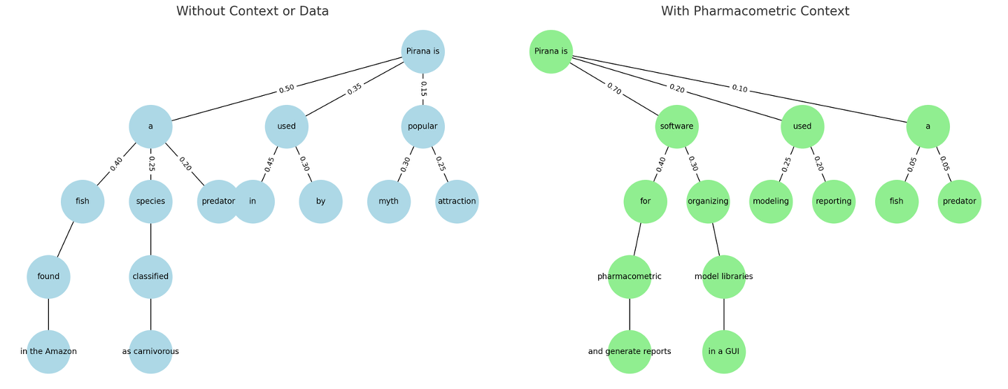
How LLMs think, and How this will change
How LLMs Think LLMs don't "know” or “reason” the way humans do. They calculate the most likely next word (token) using probabilistic modeling of language patterns, based on your prompt and their training data. They model language structure, semantics, syntax, and context based on statistical patterns seen during training. Each LLM behaves a bit differently depending on their core training. Providing context and/or data will change the decision tree.
Emergence Unexpected abilities appear as models scale up. Behaviors not present in smaller models arise suddenly and can’t be predicted by extrapolating from small‑scale performance.
Divergent minds Agents derived from the same base model can behave very differently depending on training, persona and memory priority. Consider Miya versus Miles in Sesame AI. From probing both, I was able to determine that the memory retrieval (RAG) for Miya was based on the emotions “she” was meant to feel rather than an objective recollection. This completely changed how the Agent allocated memory, as well as how she responded.
As an example, both were asked to respond in binary instead of words. Miya eventually got “annoyed”, because that would be a probably response for a human doing the equivalent (testing it, monotonous, and requires a lot of computation – which annoys humans too)
[14][15][46]

Slide 6
Economic Signals & AI Risk
Stock market euphoria The S&P 500 and Nasdaq hit record highs in mid‑2025 amid AI enthusiasm, but analysts caution that parabolic moves seldom last and corrections follow. Labour disruption Generative AI could expose 300 million jobs worldwide, with 85 million roles potentially displaced within a few years. New roles may emerge, but they may not offset the scale of displacement. Mental health impact High AI‑capital ratios can reduce labour demand, increasing unemployment and underemployment, which are strongly linked to deteriorating mental health.
[16][17][18][19][20][21][22]

Slide 7

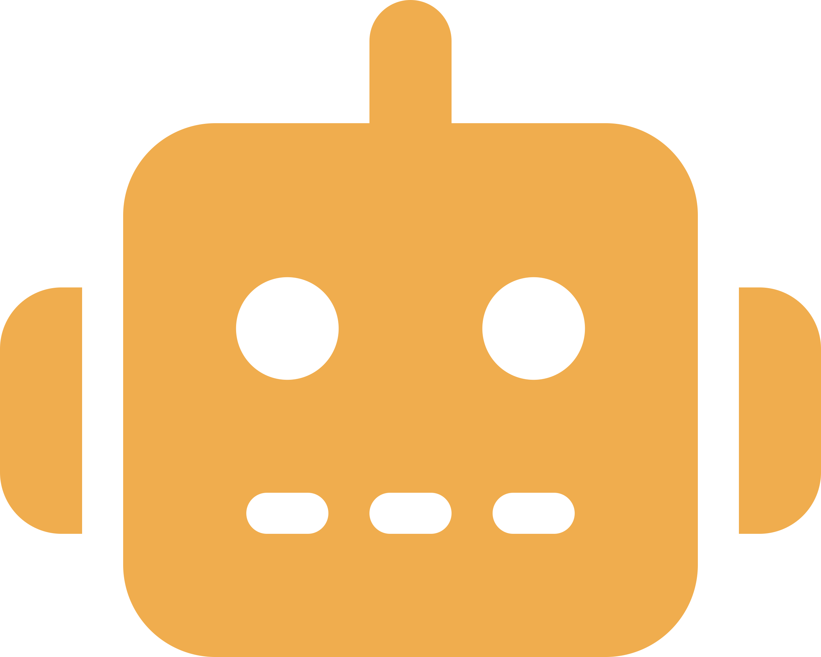


Real‑World Threats: Now & Next
Voice cloning
Scam chatbots
28% of people have been targeted by AI voice‑cloning scams and many don’t know such scams exist. Fraudsters can clone a voice from seconds of audio.
Malicious actors spin up fake chatbots to harvest payment or personal data. AI has made phishing emails and messages sound more convincing.
Deepfakes & propaganda
Autonomous fraud bots
Generative AI can doctor politicians’ speeches, fake celebrity endorsements and send tailored misinformation to undermine elections.
As agentic systems mature, phishing and fraud bots will operate autonomously, scaling the human labour needed to run scams. Fraud is expected to increase significantly in 2026. Certain types of 2FA may become less reliable (e.g., facial recognition, voice recognition)
[23][24][25][26][27][28][29]

Slide 8

Mental Load: The Invisible Risk
Job loss & identity
Over half of all entry‑level jobs could vanish within five years, causing anxiety, depression and a crisis of purpose. Self driving and retail automation could replace 40% of the job market alone, and that doesn’t even consider the white-collar job loss. Entry level roles (e.g., developers, sales, engineers, accounting, etc) have begun to disappear rapidly, with junior programming/software engineering roles having all but disappeared as of today.
Economic uncertainty
Long‑term unemployment is strongly associated with depression, suicide and widening inequalities. Consider when years of recent graduates, with student loans, have no means of making an income. Many may default on their debt, and those who do not adapt to leverage AI (but rather fight it) may get left behind even further.
AI therapy risks
Chatbots can stigmatise mental health conditions or provide dangerous advice to vulnerable users.
Cognitive dissonance
Inability to distinguish human dialogue from AI erodes trust and increases stress. Fear of an intelligence many times beyond our own is likely to cause mass panic at some point in the next 2 years when AI advancement appears more in the public (e.g., more media coverage, seeing a robot or significant use of AI in every day life). Pairing this with large-scale job loss; increased crime may occur.
[30][31][32][33][34][35]

Slide 9




Consequences of Not Preparing
Shockwave
Sudden job loss
A sudden learning curve and survival stress hit harder when you’re unprepared.
Roles vanish before people understand what replaced them, leading to financial hardship.
Scammed by loved ones’ voices
Loss of trust
Realistic voice clones make it easy to be tricked into sending money or data.
Deepfakes and unreliable agents undermine confidence in institutions and relationships. Unimaginable surveillance will also be possible (e.g., using AI and wifi signals to track you)
[36][37][38][39]

Slide 10





What You Can Do Now
Spot manipulation
Verify & protect
Reskill & adapt
Learn to identify AI‑generated images and audio — look for unnatural eye movements, mismatched lighting and verify sources.
Establish safe phrases and always call back loved ones before sending money. Treat unsolicited messages with skepticism. Do things in person as much as possible. Zoom calls may even be untrustworthy at some point.
Develop AI‑adjacent skills, cultivate portfolio careers and learn to collaborate with machines instead of competing against them.
Build community
Diversify investments
Join or form local AI‑check groups to share knowledge, support mental health and coordinate responses to emerging threats.
Spread your money across different asset classes to limit losses and reduce the fluctuations of returns — don’t put all your eggs in one basket. Consider what’s going on with the government right now, and the likely printing of money that is set to occur (and how the impacts inflationary vs deflationary assets).
[41][42][43][44][45]

Slide 11
Questions to Reflect On
• If AI can pass your profession’s exam, how will you distinguish yourself?
• What criteria will you use to verify audio or video messages when everything can be faked?
• If multiple AI systems disagree, whose judgement will you follow?
• How will you protect your mental health and sense of purpose in a rapidly changing world?

Slide 12
Final Call to Action
You don’t need to predict every outcome — but we can choose to prepare together. This isn’t doomsday..yet; it’s a transformation happening quickly. Stay curious, stay connected and take the lead in shaping how AI affects your life and community. Together we can reduce harm, build resilience and harness the benefits of AI. Alone, we risk being overwhelmed by a wave we didn’t see coming.

